Slide 1

Base Rent
Prediction in
Nordrhein Wesfalen
Project by Alvi Achmad Maulidy
http://www.free-powerpoint-templates-design.com

Slide 2
Project Goals
Predict the actual base rent in main district in state Nordrhein Westfalen, Germany.

Slide 3
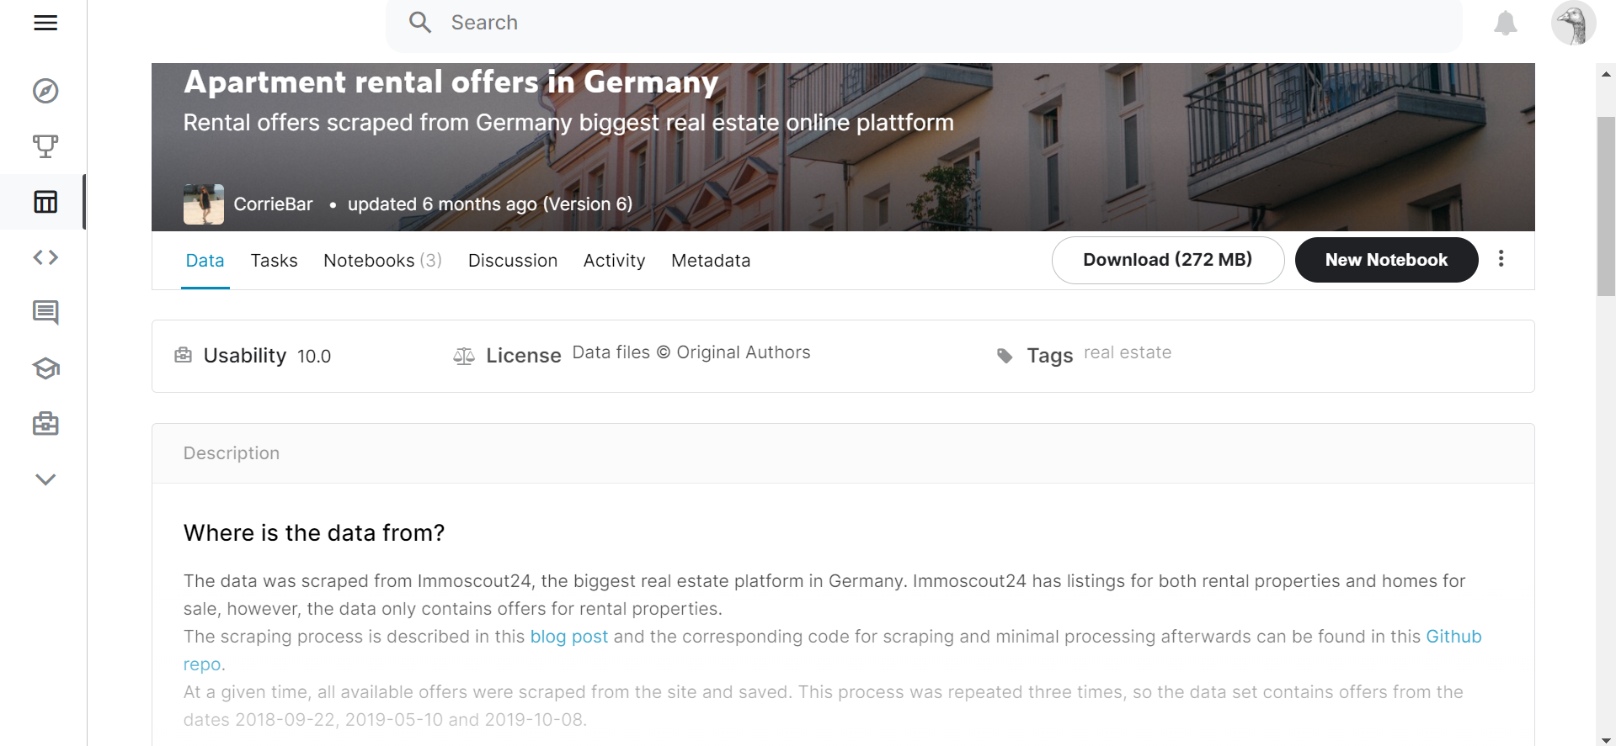
Where is the data from?
The data was scraped from Immoscout24, the biggest real estate platform in Germany. Immoscout24 has listings for both rental properties and homes for sale, however, the data only contains offers for rental properties. The scraping process is described in this blog post and the corresponding code for scraping and minimal processing afterwards can be found in this Github repo. At a given time, all available offers were scraped from the site and saved. This process was repeated four times, so the data set contains offers from the dates 2018-09-22, 2019-05-10, 2019-10-08, and 2020-02.
Contents
The data set contains most of the important properties, such as living area size, the rent, both base rent as well as total rent (if applicable), the location (street and house number, if available, ZIP code and state), type of energy etc. It also has two variables containing longer free text descriptions: description with a text describing the offer and facilities describing all available facilities, newest renovation etc. The date column was added to give the time of scraping.
Github:
https://www.kaggle.com/corrieaar/apartment-rental-offers-in-germany
Acknowledgements
The data belongs to www.immobilienscount24.de and is for research purposes only. The data was created with .

Slide 4
Process
01
Data Reprocessing
Handling missing value in dataset and recheck if there are anomaly in value
Exploratory Data Analysis
02
Looking for insight and deeper information about the data.
Feature Engineering
03
Selecting which column that will use as independent variable for model.
ML Modelling
04
.

Slide 5
Base Modelling Score
.
.
 | MAE | RMSE | R2 Score
Linear Regression | 144.74 | 46857.7 | 0.789
XGBoost | 136.6 | 46177.5 | 0.79
DecisionTreeRegressor | 186.3 | 84418.4 | 0.620
RandomForestRegressor | 135.375 | 42872.4 | 0.807
GradientBoostingRegressor | 132.81 | 42051.9 | 0.81
.

Slide 6

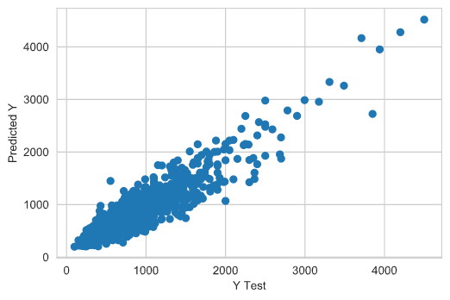
Modelling
GRADIENT BOOSTING REGRESSOR with GridSearchCV
MAE: 120.86784900683685
MSE: 30890.77399237393
R2 Score: 0.8610424182724532

Slide 7
THANK YOU

